Slide 1


LINKS
(Louisiana Immunization Network for Kids Statewide)
SCHOOL NURSE MODULE

Slide 2

Louisiana State Revised Statute 17:170
Schools in the State of Louisiana are required to report their immunization rosters under RS 17:170 which states:
    “1. Chief administrators of all elementary and secondary schools, kindergartens, colleges, universities, proprietary schools, vocational schools, and licensed day care centers whether public or private within this state shall:
      Be responsible for checking students' records to see that the provisions of this Section are enforced.
      Electronically transmit immunization compliance reports to the Louisiana Department of Health, office of public health, when the public or private school operates an existing student-specific electronic data system.
    2. The provisions of this Section which relate to the electronic transmission of data shall be implemented according to rules and regulations promulgated by the Louisiana Department of Health in accordance with the Administrative Procedure Act.”
  For more information please visit:
  http://legis.la.gov/Legis/Law.aspx?d=79952

Slide 3
What is needed to use LINKS School Nurse Module:
  Computer with internet access.
  Compatible web browser such as:
    Internet Explorer 11 or higher
    Google Chrome
    Mozilla Firefox
  Username and Password provided by LINKS administrator.

Slide 4

LINKS School Nurse Timeline:
  October 1st– Deadline for your roster to be reported in LINKS.
  June of each year – Previous year’s students will be moved up one grade.
    You may enter incoming rosters after this has been completed.
  For more information regarding school vaccination requirements, exemptions, and reporting deadlines visit the School & Childcare reporting site at
    http://ldh.la.gov/index.cfm/page/3690

Slide 5
Logging Into LINKS

Slide 6
Let’s begin – access the School Nurse Module at URL:
https://lalinks:org

Slide 7
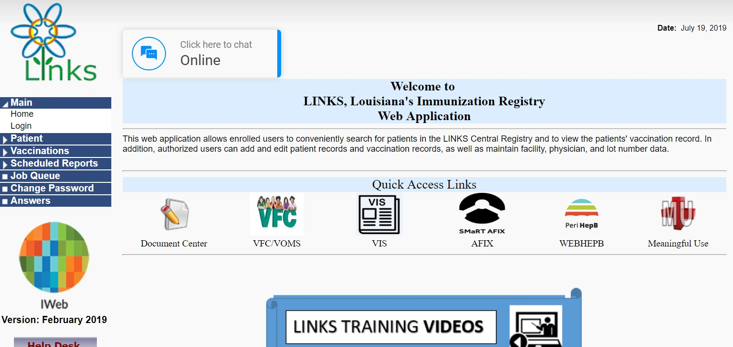
On the home page, click on Login under the Main menu.

Slide 8
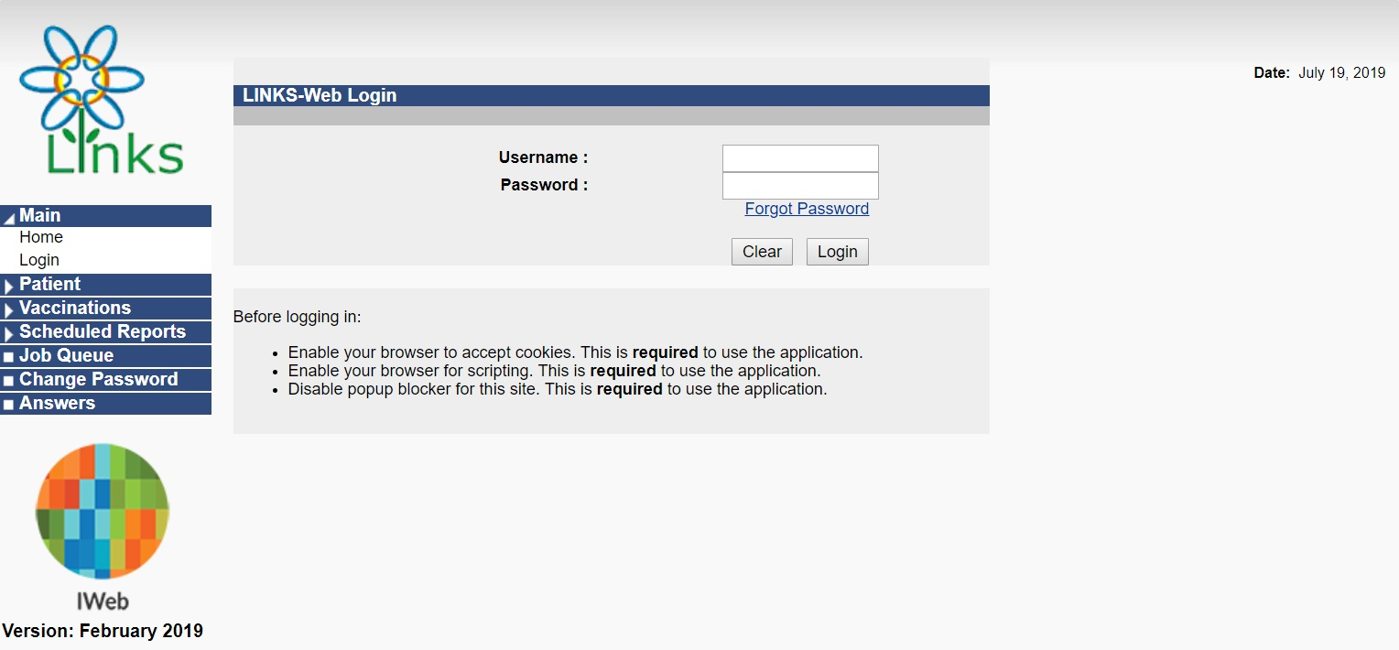
Enter your Username and Password to login.

Slide 9

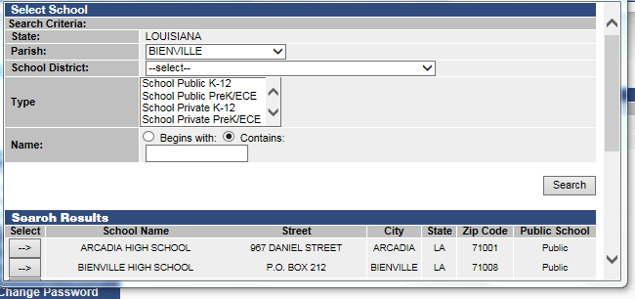

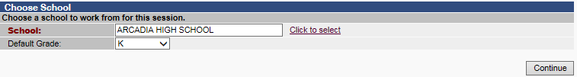
If you have access to more than one school you will need to choose the school you wish to work with > Choose Click to Select:
Select the parish if not pre-populated and click Search to show a list of the schools in the parish. Next, click the Arrow under Select.
Then click Continue on the next page.

Slide 10
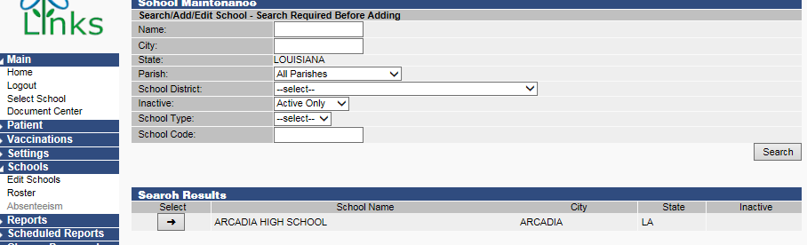
You will need to set the grades for your school by going to Schools > Edit Schools > Select your School.

Slide 11
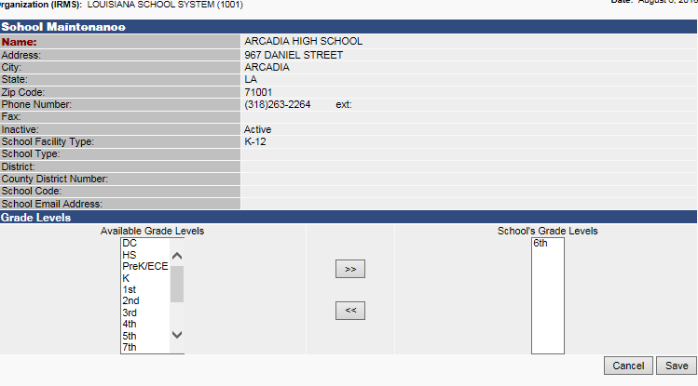
Your available grades will be listed on the left. Choose the grades that you have at your school (you can select multiple grades) and move them to the right using the Arrow button under School’s Grade Level and click Save.
IMPORTANT NOTE: If grades are listed under School Grade Levels that your school does not have, please remove them by moving them back to the left – failure to do so can make your school appear noncompliant with state vaccine reporting requirements on state department reports!

Slide 12
Searching For a
Patient and Adding to
School Roster

Slide 13
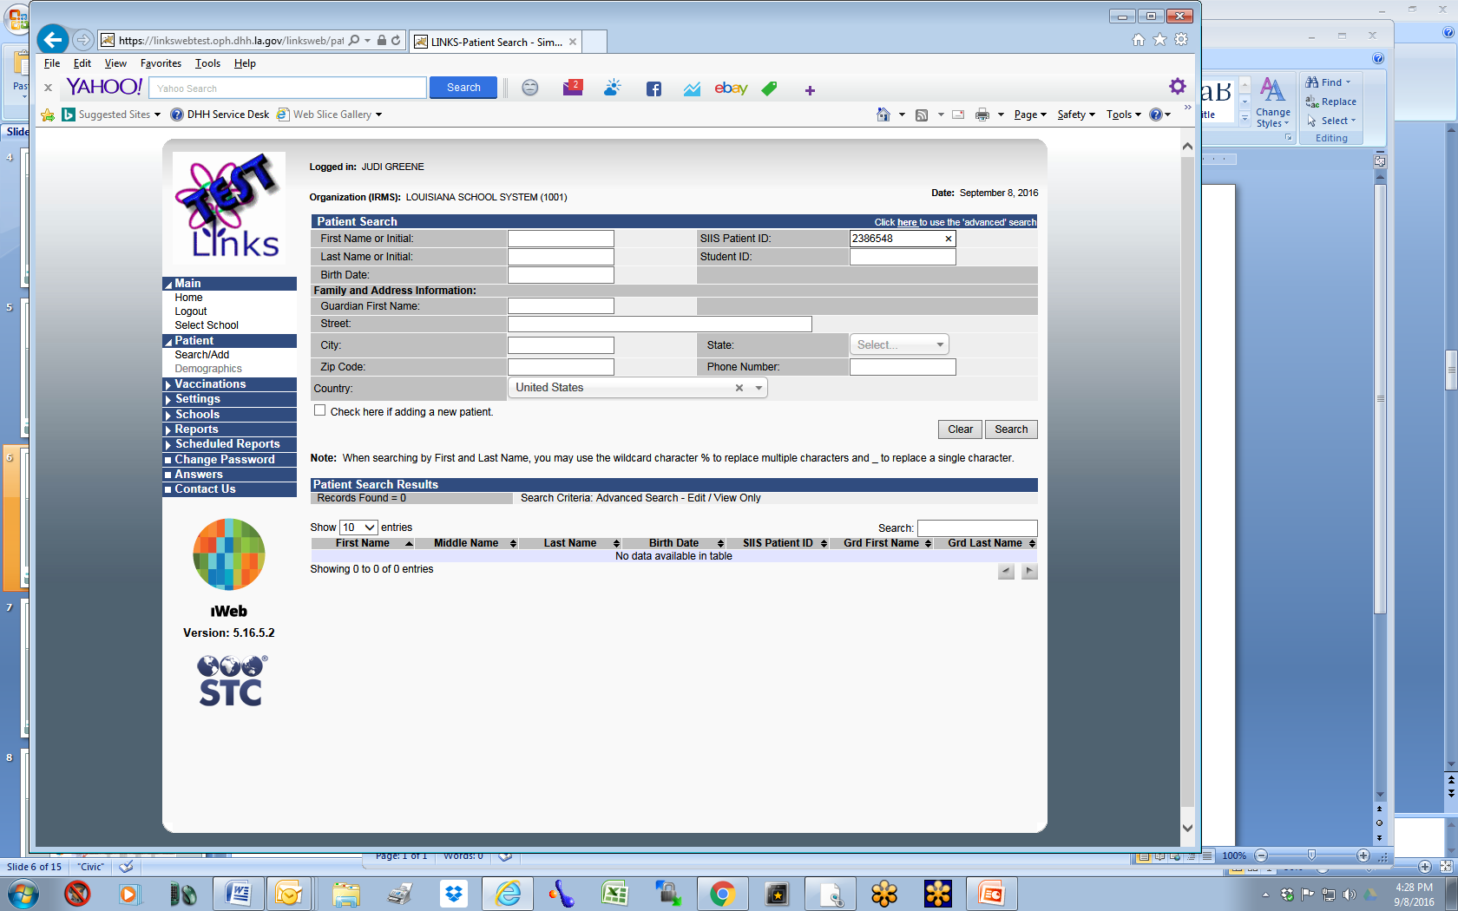
If you have the Universal Certificate of the child, you can enter the SIIS Patient ID on the certificate in the field and click Search and it will bring the child’s record up for you.

Slide 14
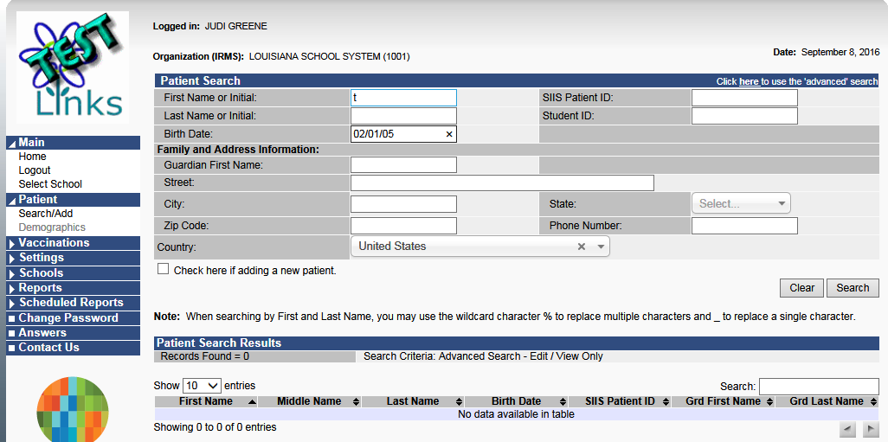

If you do not have the Universal Certificate with the SIIS Patient ID, enter the First Initial of the First Name & Date of Birth of the child. Click Search.
It is important to search using FIRST INITIAL and DATE OF BIRTH as many children have first names with alternate spellings, hyphens, and apostrophes OR may be listed under a different parent’s last name.

Slide 15
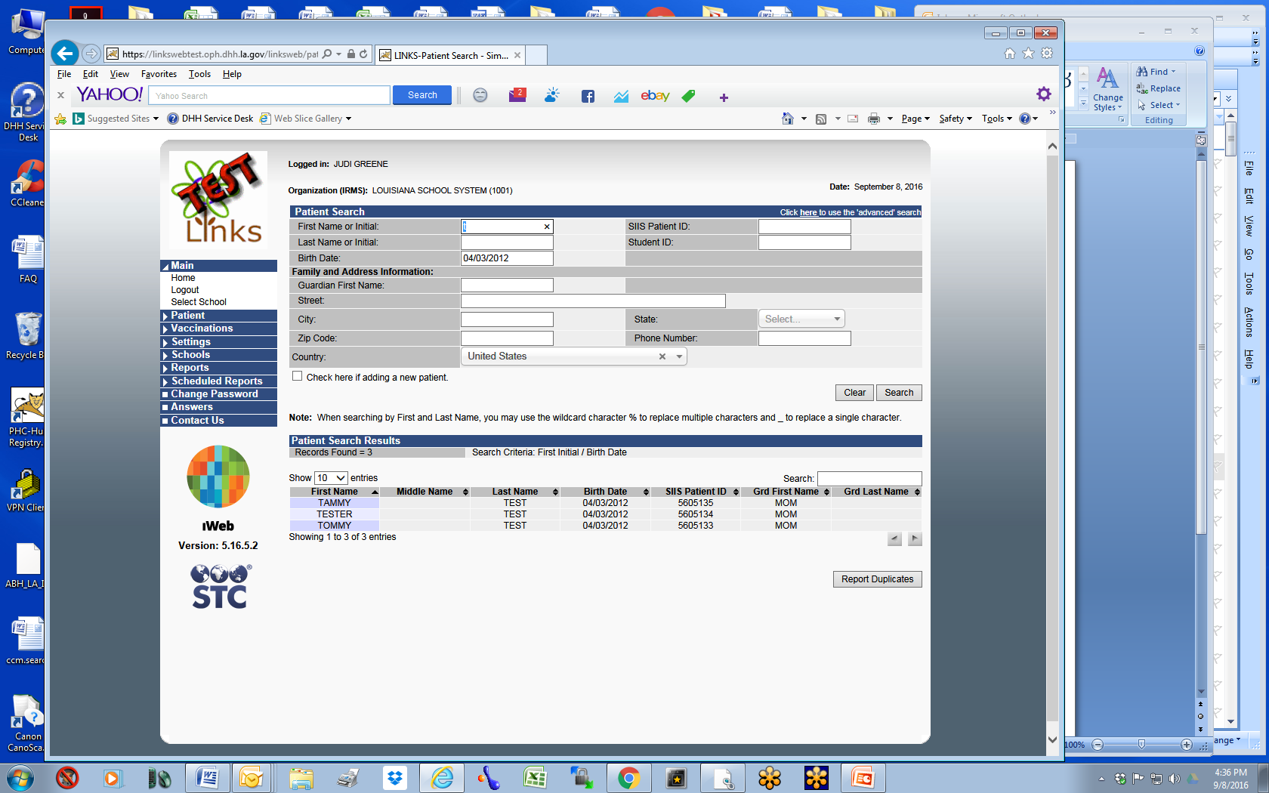

If there is a record in LINKS, it will appear under Patient Search Results.
Click on the child’s record you are searching for to proceed.

Slide 16
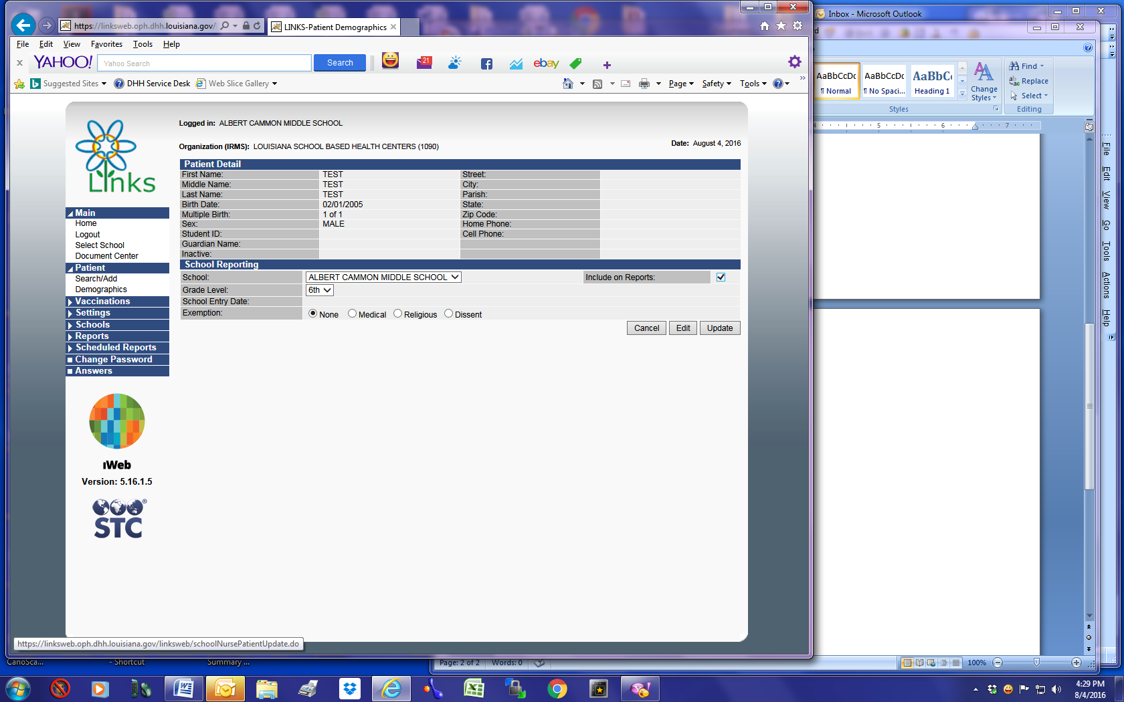
When the record is retrieved, be sure you have the correct Grade Level checked and Include on Reports then click Update. This will add the child to your school roster.

Slide 17
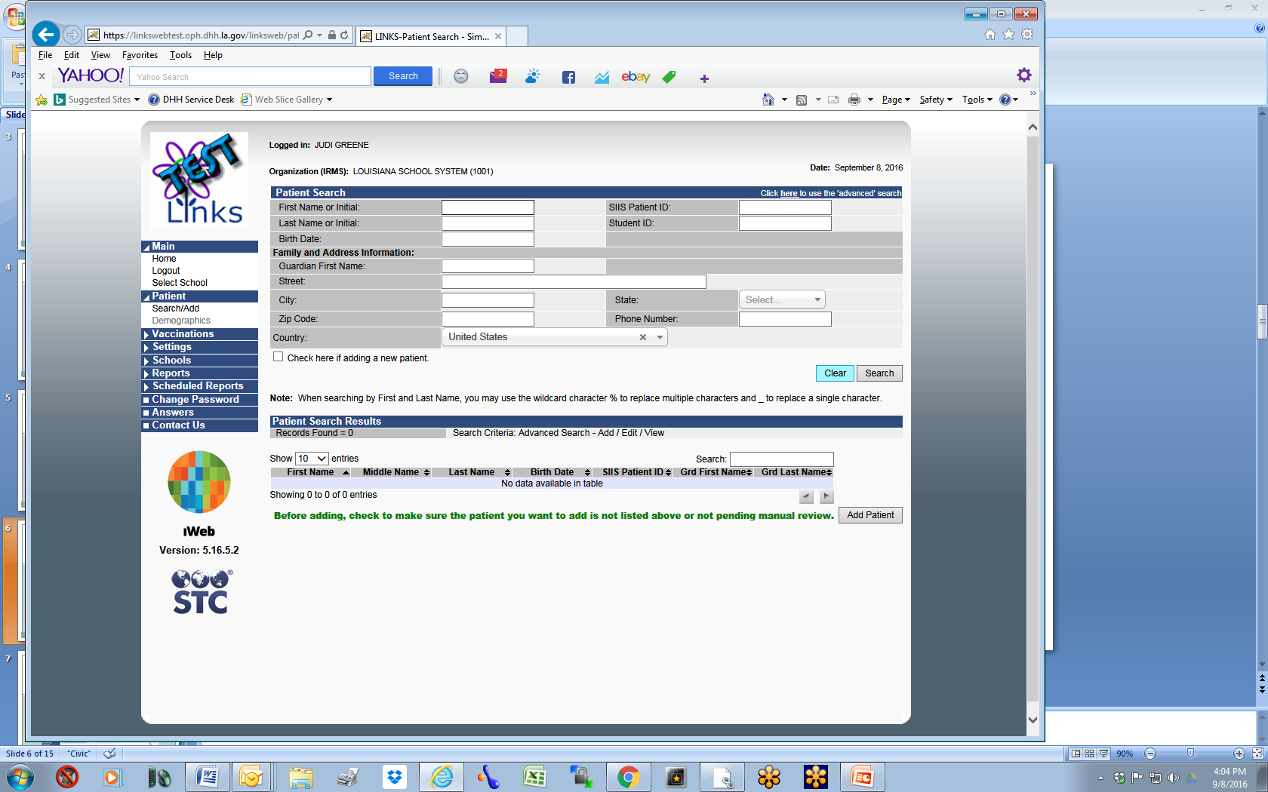

You will then click on Patient Search/Add and repeat the process until all your children are attached to your school.

Slide 18
Adding a New
Patient and Adding
to School Roster

Slide 19
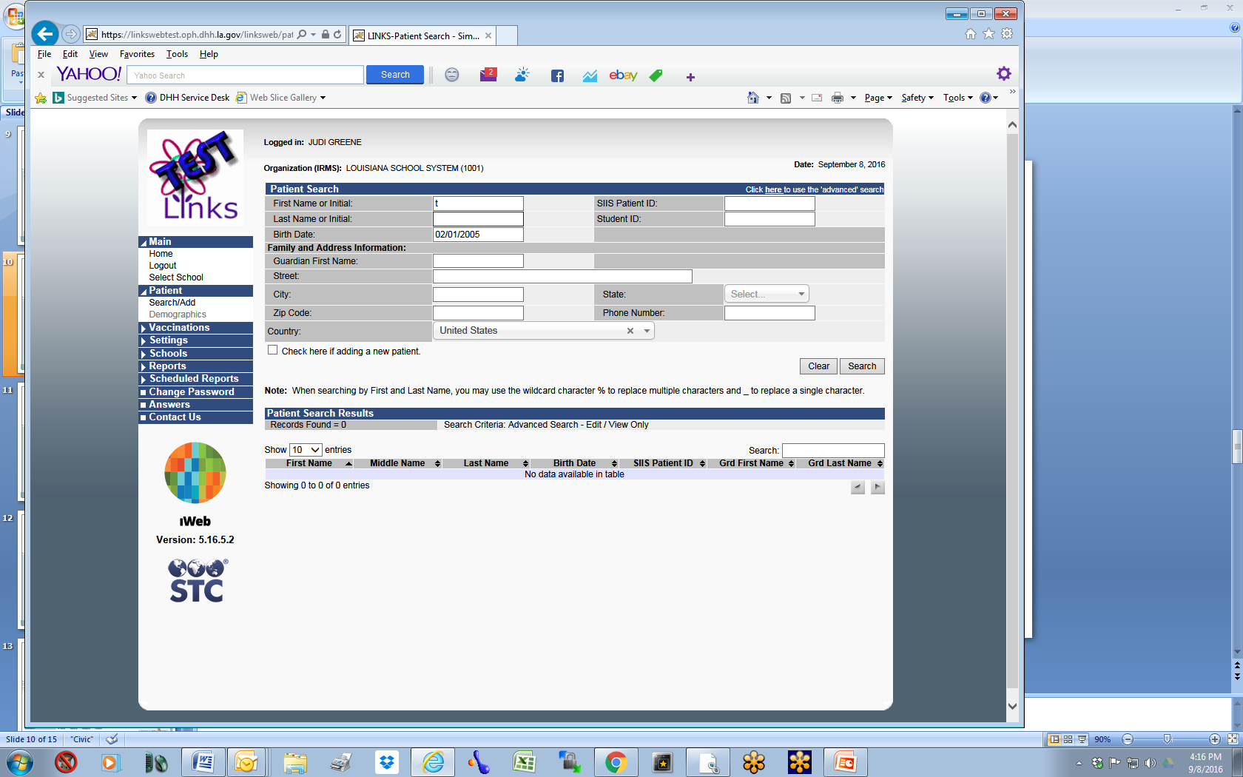
If the patient is not in LINKS, check the box on bottom left labeled “Check here if adding a new patient.” (You will notice required fields are highlighted in red.)

Slide 20
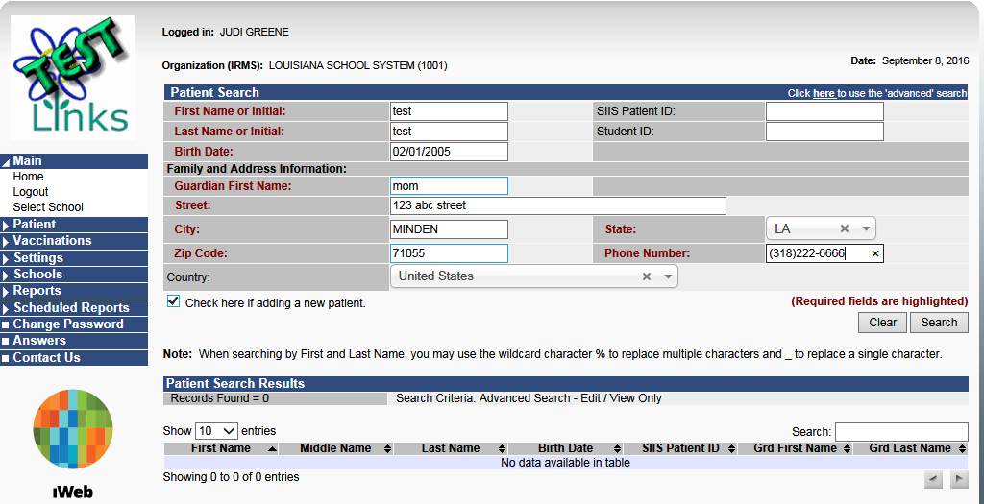
Enter the child’s information and click Search. LINKS will then search one more time before adding your entry to LINKS. You must enter all of the required fields with red text next to them before proceeding. (Note: When filling out the address, entering the Zip Code will auto populate the city & state.)

Slide 21
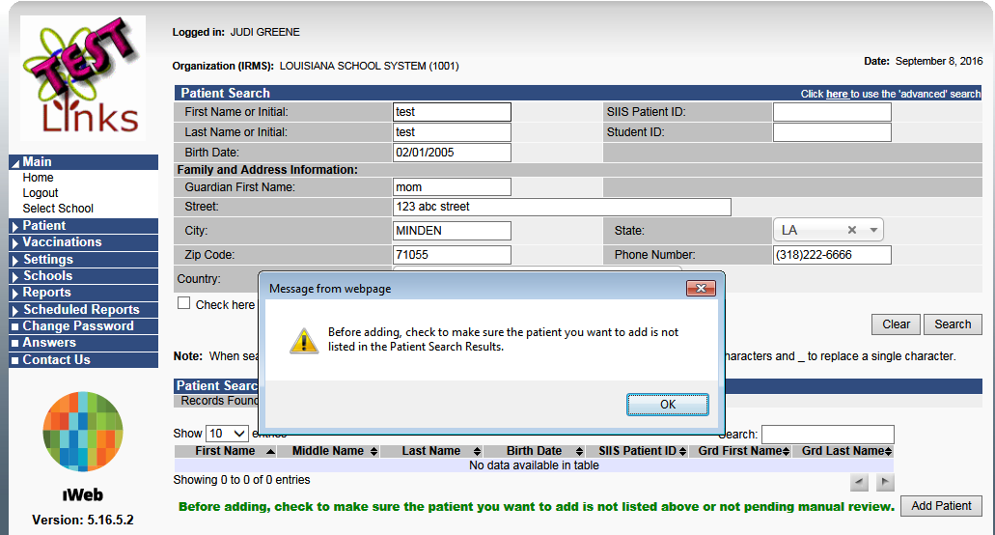
A message box stating “Before adding, check to make sure the patient you want to add is not listed in the Patient Search Results” will appear. Click OK and click Add Patient.

Slide 22
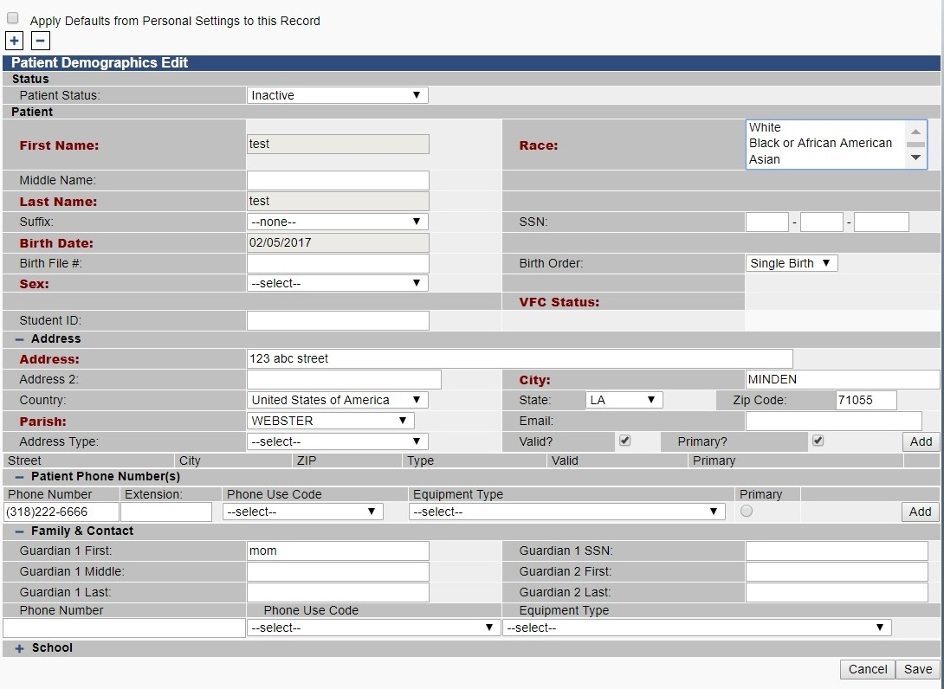
Before continuing, you must select the child’s Race and Sex. LINKS will not allow you to proceed without entering this information.

Slide 23

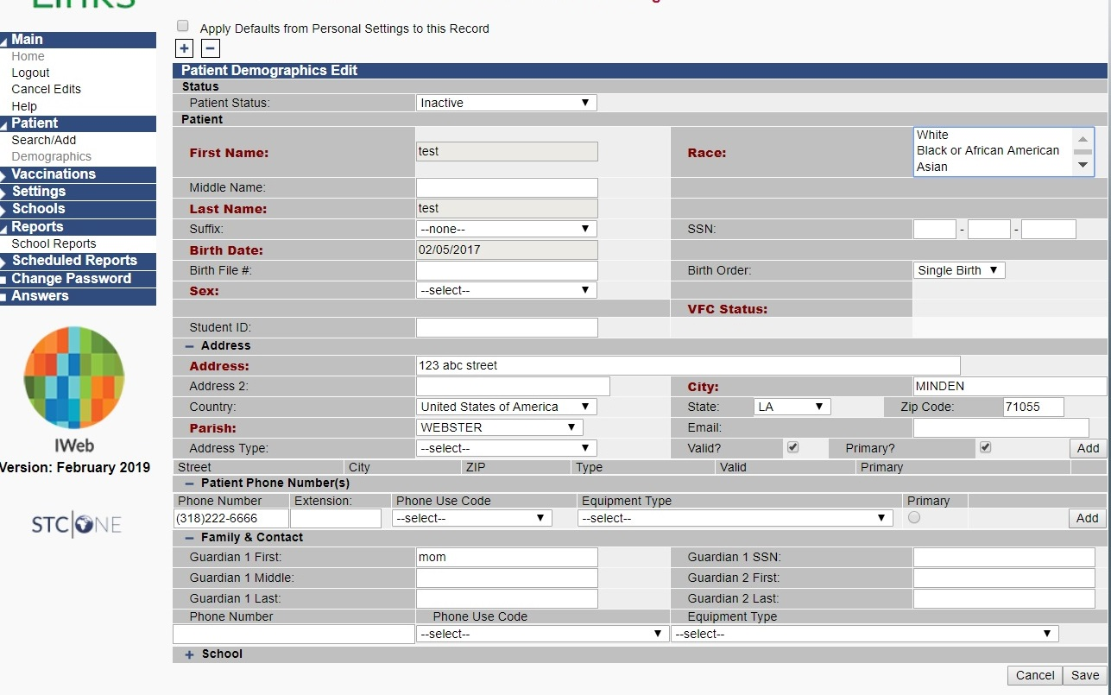
You must also hit Add to save the child’s Address information. Finally, specify a Phone Use Code and hit Add to save their phone number.

Slide 24
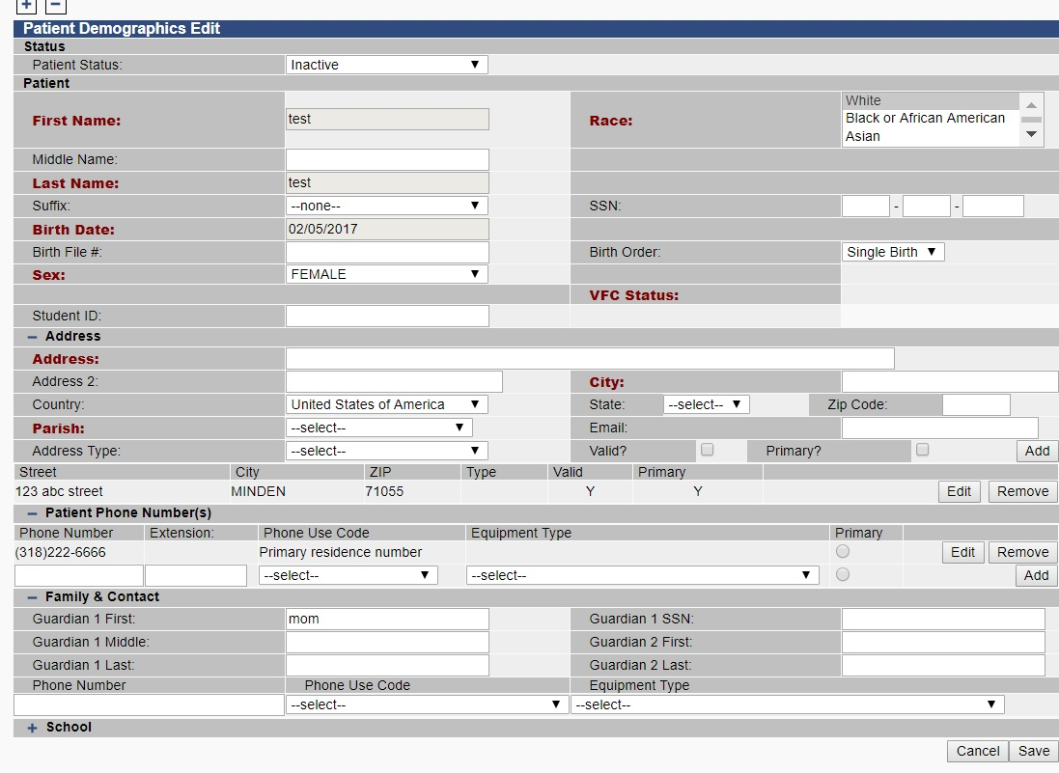
When the Address and Phone Number are properly added, they will be displayed underneath each section. You may then hit Save to add your patient to LINKS.

Slide 25
To complete addition of the child to your school roster, you will check Include on Reports and Update.

Slide 26
Vaccine Exemptions

Slide 27
If the parent is claiming an exemption for Medical or Religious reasons or because they Dissent for philosophical reasons, please indicate it by selecting the appropriate button before selecting Update to save the child to your roster.

Slide 28
Adding Historical Vaccine Information

Slide 29
From time to time, you will need to add a vaccine records that is not in LINKS. You must do so as a historical vaccination.
For information on how to add historical vaccinations, please see this instructional video:
https://www.youtube.com/watch?v=BYs4DswM5pw
IMPORTANT NOTE: If you encounter an error while entering a historical vaccine, please contact LINKS staff – information on how is included at the end of this presentation.

Slide 30
School Reports

Slide 31
Action Report
This report will indicate any students due for vaccines and the due date.
Use this report to follow-up with students and parents to ensure that overdue vaccinations are being completed.

Slide 32
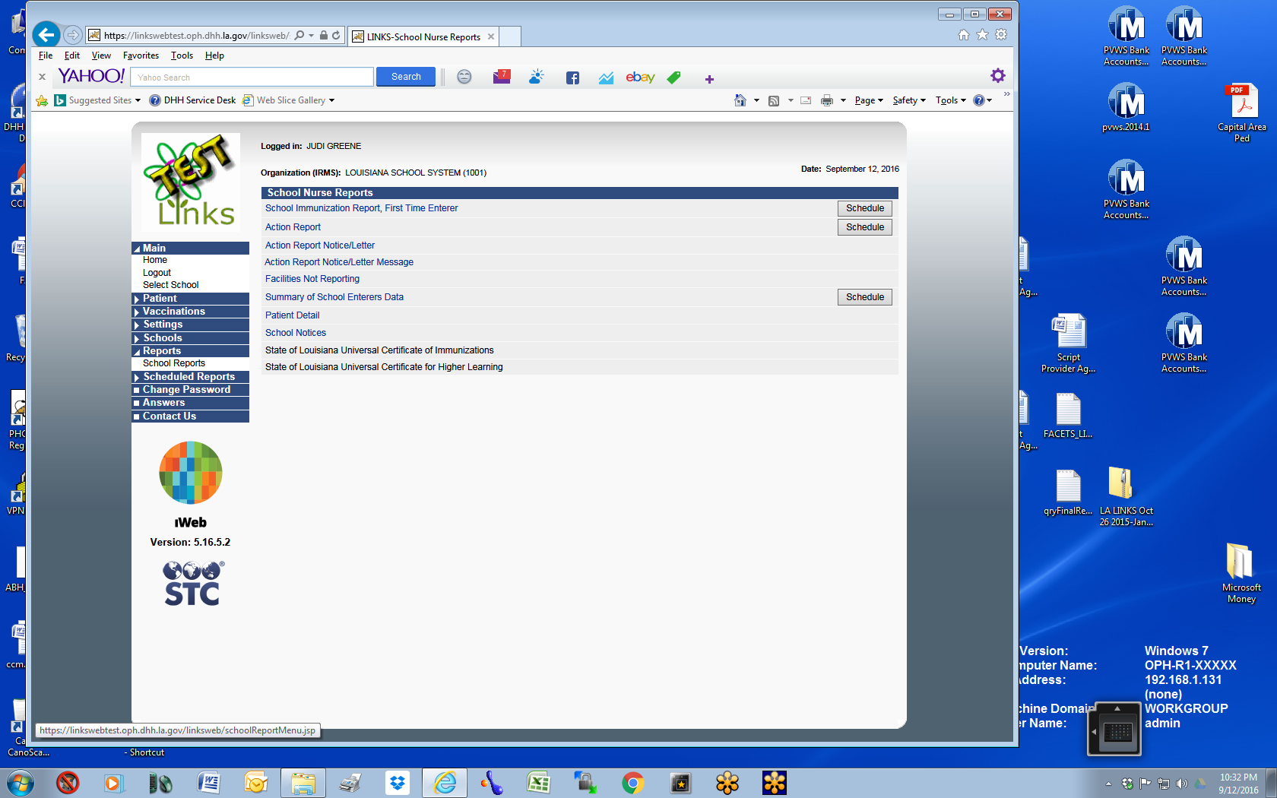
Go to Reports > School Reports > Select Action Report.

Slide 33
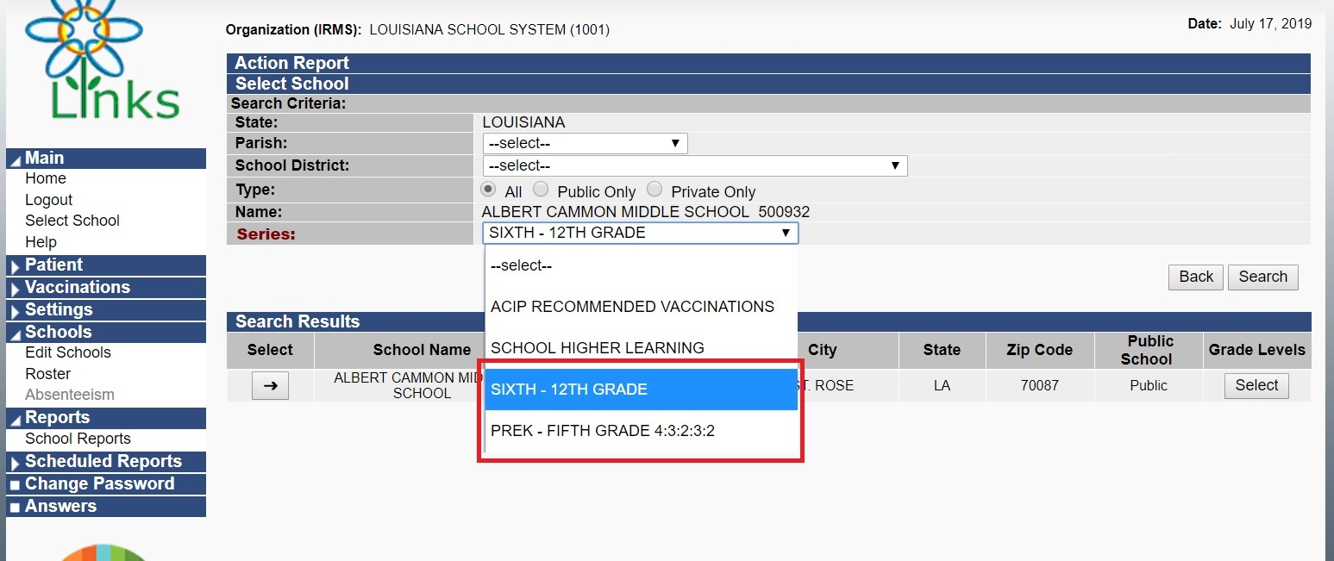
Select your Series: Either “PREK – FIFTH GRADE 4:3:2:3:2” OR “SIXTH – 12TH GRADE” based on the grade levels you are working with at that time.

Slide 34
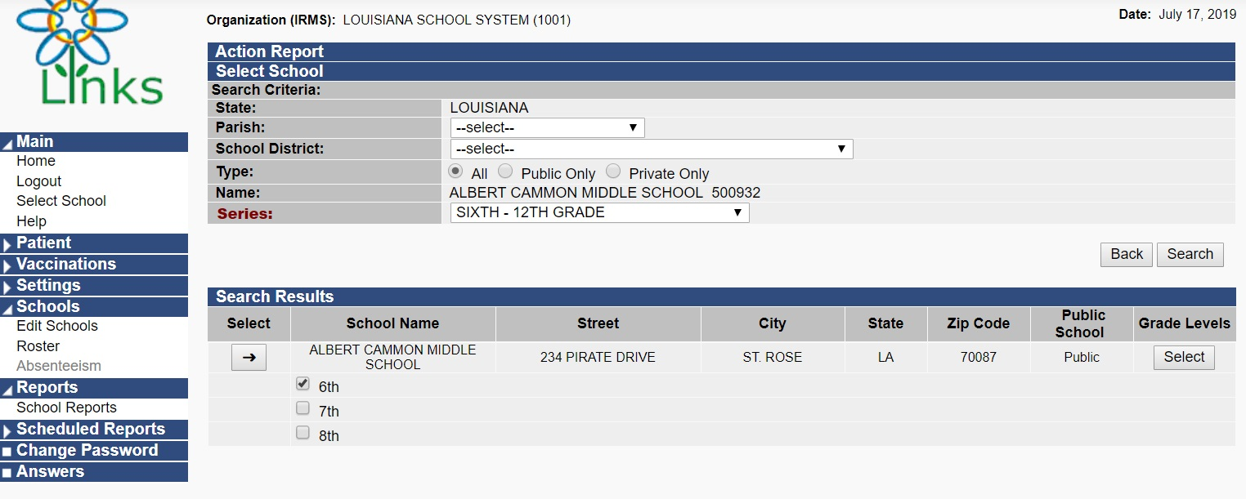
Select the Grade(s) you wish to run your report on and then hit Select:

Slide 35
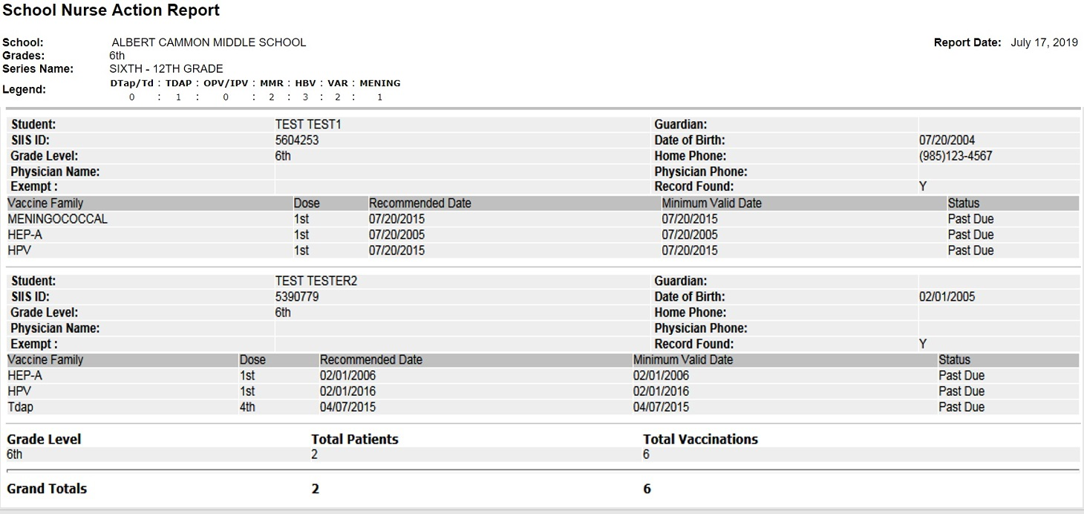
Your Action Report will show each student that needs Recommended Vaccinations including Recommended Date, Minimum Valid Date, & Status.

Slide 36
Who do I contact if I have
questions or problems?

Slide 37
LINKS now provides support chat from the home page! This is the fastest place to get help.
If support chat cannot answer your question, they will forward it to the appropriate person on the LINKS team.

Slide 38
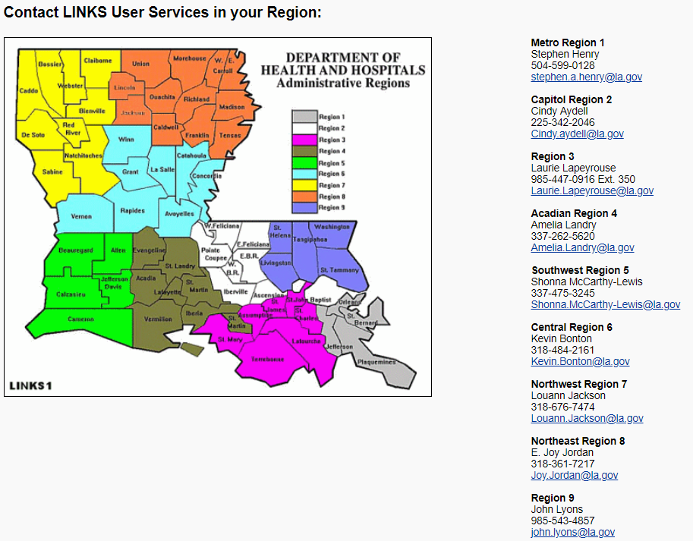
If you have an urgent question that chat is unable to answer or need assistance with another issue related to immunizations, please contact your Regional Immunization Consultant. Their information is located at the bottom of the LINKS homepage.

Slide 39
LINKS System Administrators
Rachel York, LINKS Program Manager
Email: Rachel.york@la.gov
Judi Greene, LINKS Operations Manager
Email: judi.greene@la.gov

